Slide 1
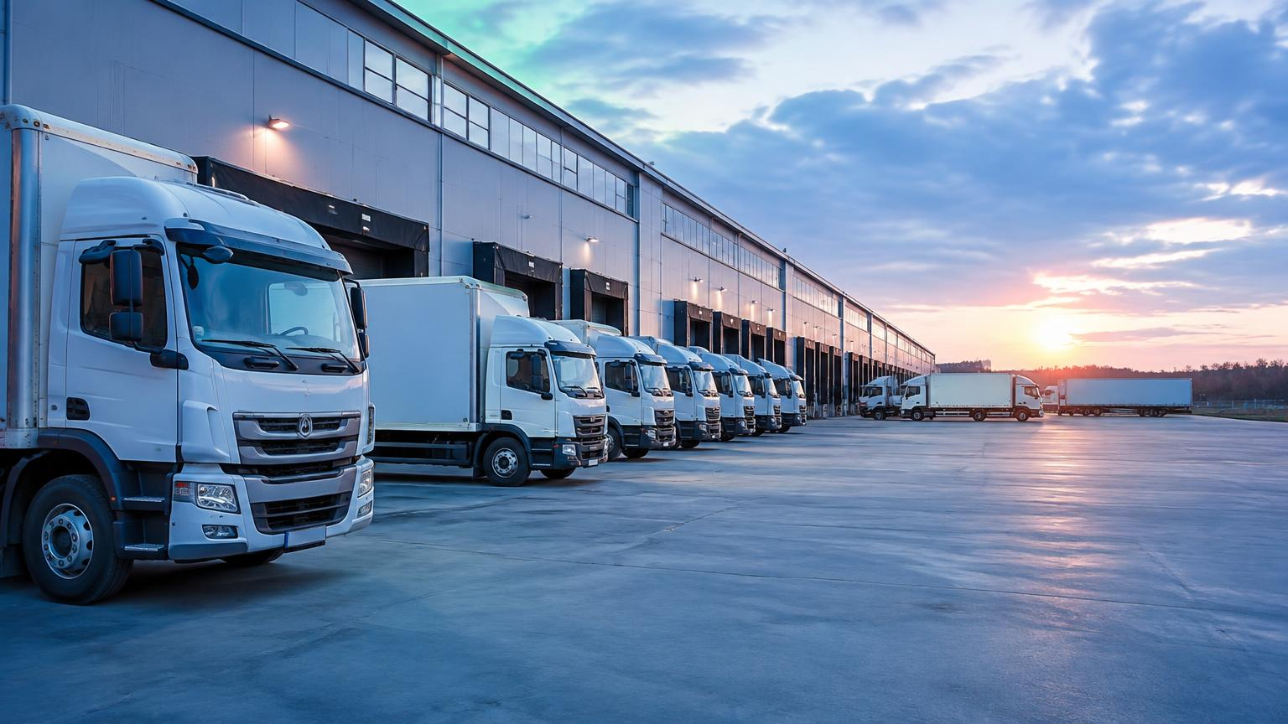
DAY 4 • 28 SEPTEMBER 2026
Vehicle Transport Management
Fleet economics, network design, compliance and the road to green fleets
Session 1: 8:45–10:45 | Session 2: 11:30–1:30
BBA Marketing and Automobile Management | GU Campus, Greater Noida

Slide 2
DAY AGENDA
Day 4 — Schedule at a Glance
8:45 – 10:45 · Session 1
10:46 – 11:30 · Tea Break
Fleet and Transport Management Fundamentals
Networking with industry experts
11:30 – 1:30 · Session 2
1:30 onwards · Lunch and Felicitation
Regulatory Compliance and Sustainability
Close of the 4-day workshop
Timings follow the official 4-day workshop schedule.

Slide 3
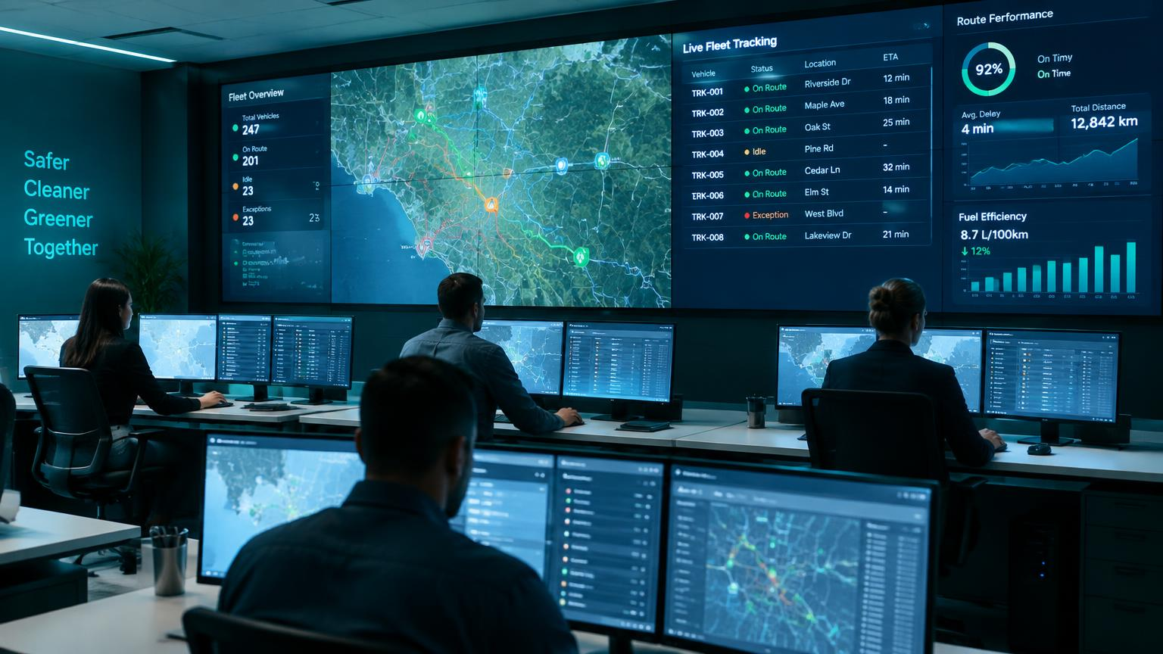
01
SESSION 1 • 8:45 – 10:45
Fleet and Transport Management Fundamentals
Sizing, costing and routing a fleet as a management discipline — not a maintenance chore

Slide 4
SESSION 1 • LEARNING OBJECTIVES
What you will be able to do
1
Explain the core decisions in fleet composition planning and vehicle selection
2
Apply total cost of ownership thinking to a fleet vehicle purchase decision
3
Compare hub-and-spoke and point-to-point network designs
4
Describe route optimisation and last-mile delivery economics
5
Explain how telematics supports day-to-day fleet decisions
⏱ Duration: 120 minutes, including tutorial and quiz

Slide 5
SESSION 1 • CONCEPT
Fleet Composition Planning
Vehicle type and capacity
Owned vs leased vs hired
Matched to the load profile — weight, volume and typical distance per trip.
The mix balances capital intensity against flexibility and scalability.
Fleet age and replacement cycle
Fuel type mix
Balances rising maintenance cost against depreciation and resale value.
Diesel, CNG or electric — chosen on route profile and total cost of ownership.
3–5 yrs typical replacement cycle for light commercial vehicles in intensive use

Slide 6
SESSION 1 • CONCEPT
TCO Components for a Fleet Vehicle
Component | Description
Acquisition cost | Purchase price or lease cost of the vehicle
Fuel / energy cost | The largest recurring cost, driven by route and driving pattern
Maintenance and repair | Scheduled service, wear parts and unscheduled repair
Insurance and compliance | Premiums, permits and fitness-certificate renewals
Driver cost | Salary, incentives and training
Depreciation / resale value | Residual value realised when the vehicle is disposed of
Rule of thumb: the purchase price is only the entry ticket — lifetime cost is decided by fuel, driver and maintenance.

Slide 7
SESSION 1 • CONCEPT
Network Design Choices
Hub-and-Spoke
Point-to-Point
Central hubs consolidate and sort freight before onward movement
Fewer, larger vehicle movements between hubs improve efficiency at scale
Adds a transfer step and time — best for large, dispersed networks
Freight moves directly from origin to destination, no intermediate hub
Faster for high-volume, high-density lanes
Less efficient for scattered, low-volume demand
▶ Watch: hub-and-spoke vs point-to-point
A 3-minute comparison to watch before the tutorial.

Slide 8
SESSION 1 • CONCEPT
Route Optimisation and Last-Mile Delivery
01
02
03
04
Demand aggregation
▸
Route sequencing
▸
Dispatch and tracking
▸
Proof of delivery
Orders are clustered by area and delivery time window
Software optimises stop order to minimise distance and time
GPS-enabled real-time visibility of every vehicle in motion
The loop closes and data feeds the next planning cycle
Last-mile cost is where most delivery businesses win or lose their margin.

Slide 9
SESSION 1 • CONCEPT
Telematics and GPS Fleet Tracking
Real-time visibility
Live location and accurate ETAs for customers and dispatchers
Driver behaviour
Harsh braking, speeding and idling flagged for coaching
Fuel and theft detection
Consumption tracking flags pilferage or inefficient driving
Predictive maintenance
Diagnostics can flag a service need before a breakdown
10–15%
illustrative fuel savings reported from telematics-driven driver coaching
▶ Watch: what is telematics?

Slide 10
SESSION 1 • TUTORIAL / IN-CLASS ACTIVITY
Fleet Sizing and Route Case Exercise
⏱ 20 minutes • Small groups
1. Each group receives a delivery brief: daily demand volume, number of zones, vehicle capacity and average zone-to-zone distance.2. Calculate the minimum number of vehicles needed to cover daily demand within the shift window — show your working.3. Decide whether hub-and-spoke or point-to-point fits this demand pattern, and justify the choice.4. Name one telematics metric you would track in month one to validate your fleet plan.
Deliverable: a one-page fleet-sizing worksheet with vehicle count, network-design choice and chosen telematics metric.

Slide 11
SESSION 1 • QUIZ
Quick Check — Questions 1 to 3
1. Total cost of ownership for a fleet vehicle includes all of the following EXCEPT:
A. Fuel cost
B. Driver cost
C. Brand advertising spend
D. Maintenance cost
2. A design where freight is consolidated at central hubs before onward movement is called:
A. Point-to-point
B. Hub-and-spoke
C. Milk run only
D. Cross-docking only
3. Point-to-point network design is generally most efficient for:
A. Scattered, low-volume demand
B. High-volume, direct lanes
C. Only air cargo
D. Only rail freight

Slide 12
SESSION 1 • QUIZ
Quick Check — Questions 4 to 6
4. Route optimisation software primarily helps by:
A. Reducing driver salaries
B. Sequencing stops to cut distance/time
C. Removing the need for insurance
D. Replacing telematics
5. Telematics data can be used for all of the following EXCEPT:
A. Real-time location tracking
B. Driver behaviour monitoring
C. Predictive maintenance alerts
D. Setting road tax rates
6. The largest recurring cost component in most fleet TCO models is typically:
A. Insurance
B. Fuel / energy cost
C. Driver training
D. Vehicle depreciation

Slide 13
SESSION 1
Answer Key — Session 1 Quiz
Q1 · C
Q4 · B
Advertising isn't a TCO component
Optimises stop sequencing
Q2 · B
Q5 · D
Hubs consolidate freight
Road tax is set by regulation
Q3 · B
Q6 · B
Point-to-point suits dense lanes
Fuel dominates recurring cost

Slide 14
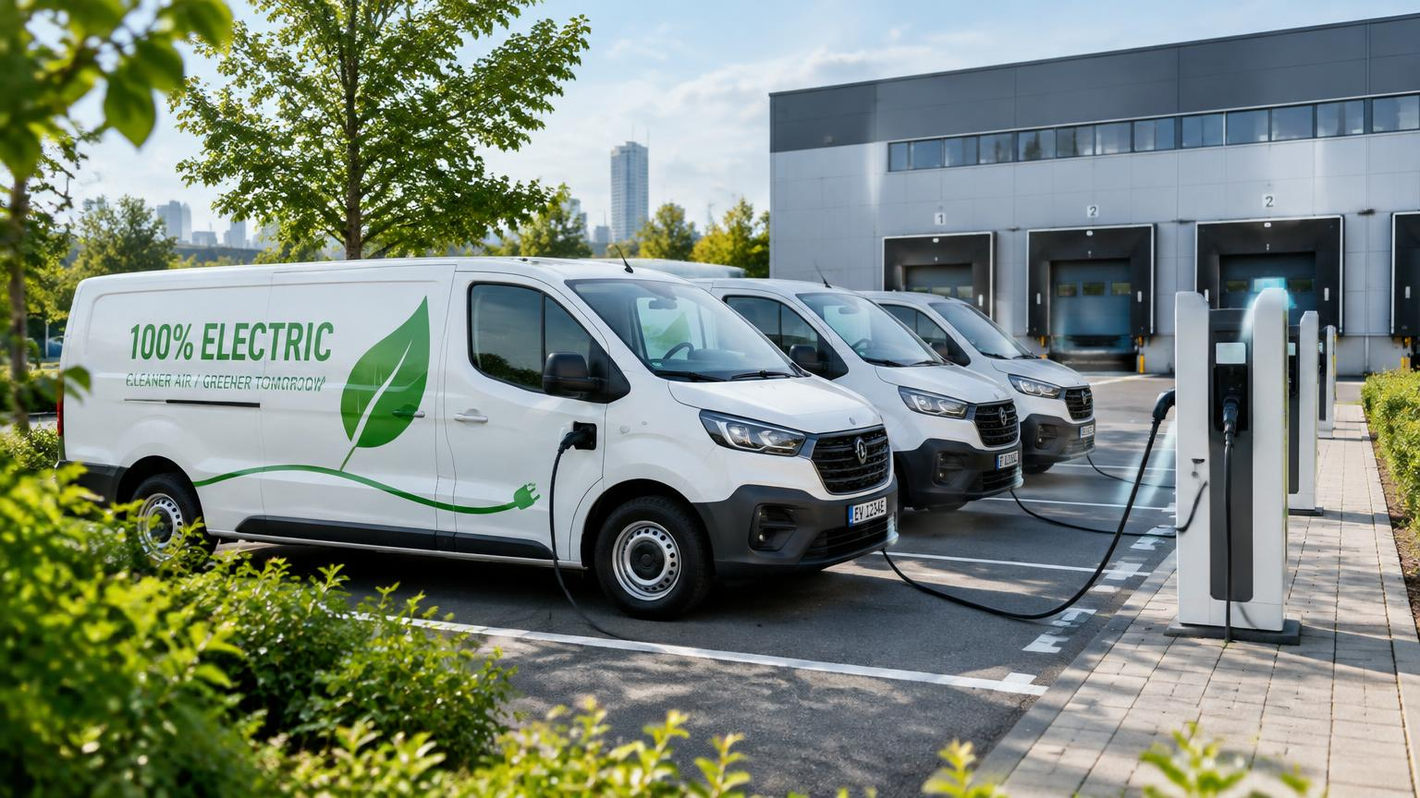
02
SESSION 2 • 11:30 – 1:30
Regulatory Compliance and Sustainability
Permits, e-way bills, driver safety, emission norms — and the shift to green fleets

Slide 15
SESSION 2 • LEARNING OBJECTIVES
What you will be able to do
1
Identify the key permits and licences required to run a commercial fleet in India
2
Explain the e-way bill requirement and its role in goods-movement compliance
3
Describe driver licensing, safety management and fatigue management
4
Explain BS-VI emission norms and their impact on fleet composition
5
Outline how fleet KPIs and green-fleet adoption shape transport strategy
⏱ Duration: 120 minutes, including tutorial and quiz

Slide 16
SESSION 2 • CONCEPT
Key Permits and Compliance Documents
Document | Purpose
National / State Permit | Authorises commercial operation across state or national routes under the Motor Vehicles Act
Fitness Certificate | Certifies roadworthiness; must be renewed periodically
Commercial / Heavy Licence | Authorises driving of goods or passenger commercial vehicles
Insurance (third-party) | Third-party cover is mandatory; comprehensive cover is recommended for fleet assets
PUC Certificate | Confirms the vehicle meets emissions compliance requirements
One lapsed document can ground a vehicle — compliance is an operations job, not a back-office one.

Slide 17
SESSION 2 • CONCEPT
The E-Way Bill, at a Glance
₹50,000
1 day / 200 km
₹10,000+
Consignment value above which an e-way bill is mandatory for inter-state goods movement
Standard validity period for regular cargo under CGST rules
Minimum penalty for non-compliance, alongside possible detention of vehicle and goods
Intra-state thresholds vary by state (some allow up to ₹2,00,000) — always verify the applicable state notification before planning a shipment.
▶ Watch: e-way bill rules explained

Slide 18
SESSION 2 • CONCEPT
Driver and Safety Management
Licensing tiers
Fatigue management
Light Motor Vehicle, Heavy Motor Vehicle and commercial badge requirements apply by vehicle class.
Structured rest breaks reduce fatigue-related accidents on long-haul routes.
Training and safety scoring
Insurance and liability
Increasingly driven by telematics data rather than periodic manual reviews.
Third-party cover is mandatory; comprehensive cover is standard for fleet assets.
The safest fleets treat driver coaching as a weekly habit, not an annual event.

Slide 19
SESSION 2 • CONCEPT
Emissions and the Green Fleet Transition
BS-VI emission norms
In force since April 2020, with tightened Real Driving Emission checks added later; strict NOx and particulate limits
CNG and LNG
Transitional lower-emission fuels widely adopted by commercial fleets
Electric fleet adoption
Growing fastest in last-mile urban logistics and intra-city bus fleets
Carbon reporting
Increasingly expected by large corporate shippers from their logistics partners
Emissions are now a fleet-planning input, not an afterthought.

Slide 20
SESSION 2 • CONCEPT
Common Fleet KPIs
KPI | What it measures
Vehicle utilisation | Share of available vehicle-time actually in productive use
Cost per km | Total operating cost divided by distance run
On-time delivery % | Service reliability from the customer's perspective
Fuel efficiency (km/l or km/kWh) | Energy efficiency of the fleet
Downtime / breakdown rate | Effectiveness of the maintenance programme
Pick three KPIs and review them weekly — a dashboard nobody reads changes nothing.

Slide 21
SESSION 2 • TUTORIAL / IN-CLASS ACTIVITY
Compliance Audit Exercise
⏱ 20 minutes • Pairs or small groups
1. Each group receives a mini fleet profile — for example a 10-vehicle intra-city goods fleet running diesel light commercial vehicles.2. Using this session’s permits table, build a checklist covering permits, licences, insurance, PUC and e-way bill applicability.3. Identify one likely compliance gap for a fleet like this (say, an expired fitness certificate) and propose a corrective action.4. Propose one KPI from the KPI table this fleet should start tracking, and explain why.
Deliverable: a completed compliance checklist plus one proposed KPI with a one-line justification.

Slide 22
SESSION 2 • QUIZ
Quick Check — Questions 1 to 3
1. An e-way bill is generally mandatory for inter-state goods movement above what value?
A. ₹10,000
B. ₹25,000
C. ₹50,000
D. ₹1,00,000 uniformly
2. Which certificate confirms a vehicle's roadworthiness and must be renewed periodically?
A. PUC certificate
B. Fitness certificate
C. Driving licence
D. Insurance policy
3. BS-VI emission norms in India have been in force since:
A. 2015
B. 2017
C. April 2020
D. 2025

Slide 23
SESSION 2 • QUIZ
Quick Check — Questions 4 to 6
4. Which of these fleet KPIs measures service reliability?
A. Cost per km
B. On-time delivery %
C. Fuel efficiency
D. Vehicle utilisation
5. A commercial goods vehicle driver in India typically requires:
A. Any valid LMV licence
B. A commercial/heavy-vehicle licence
C. No licence, only registration
D. Only a learner’s permit
6. The regular-cargo validity period for an e-way bill is approximately:
A. 1 day per 50 km
B. 1 day per 200 km
C. 1 day per 500 km
D. Unlimited once issued

Slide 24
SESSION 2
Answer Key — Session 2 Quiz
Q1 · C
Q4 · B
₹50,000 is the standard threshold
On-time delivery measures reliability
Q2 · B
Q5 · B
Fitness certificate confirms roadworthiness
A commercial licence is required
Q3 · C
Q6 · B
BS-VI began April 2020
1 day per 200 km for regular cargo

Slide 25
STUDENT HANDOUT
Day 4 — Key Points to Keep
1. TCO beats sticker price
2. Match network to demand
3. Last mile decides margin
Fuel, driver, maintenance and resale decide lifetime cost.
Hub-and-spoke for dispersed volume; point-to-point for dense lanes.
Clustering, sequencing and proof of delivery are the levers.
4. Telematics is management data
5. Compliance is operational
6. Green fleets are planning inputs
Location, driver behaviour, fuel and predictive maintenance.
Permit, fitness, licence, insurance, PUC, e-way bill.
BS-VI, CNG/LNG, EV last mile, carbon reporting.
MY TAKEAWAY: ______________________________________________________________________________
MY QUESTION: ______________________________________________________________________________
Videos used today: hub-and-spoke vs point-to-point • what is telematics • e-way bill rules explained

Slide 26
DAY SUMMARY
Day 4 Key Takeaways — and Workshop Close
Fleet decisions are TCO decisions, not purchase-price decisions
Network design should match demand density and volume — hub-and-spoke and point-to-point are tools, not defaults
Telematics turns fleet management into a real-time, data-driven discipline
Compliance lapses can ground a vehicle or a shipment — permits, e-way bills, PUC and licensing matter daily
BS-VI and green fleets make emissions a core fleet-planning input
Thank you — end of the 4-day industrial workshop

