Slide 1
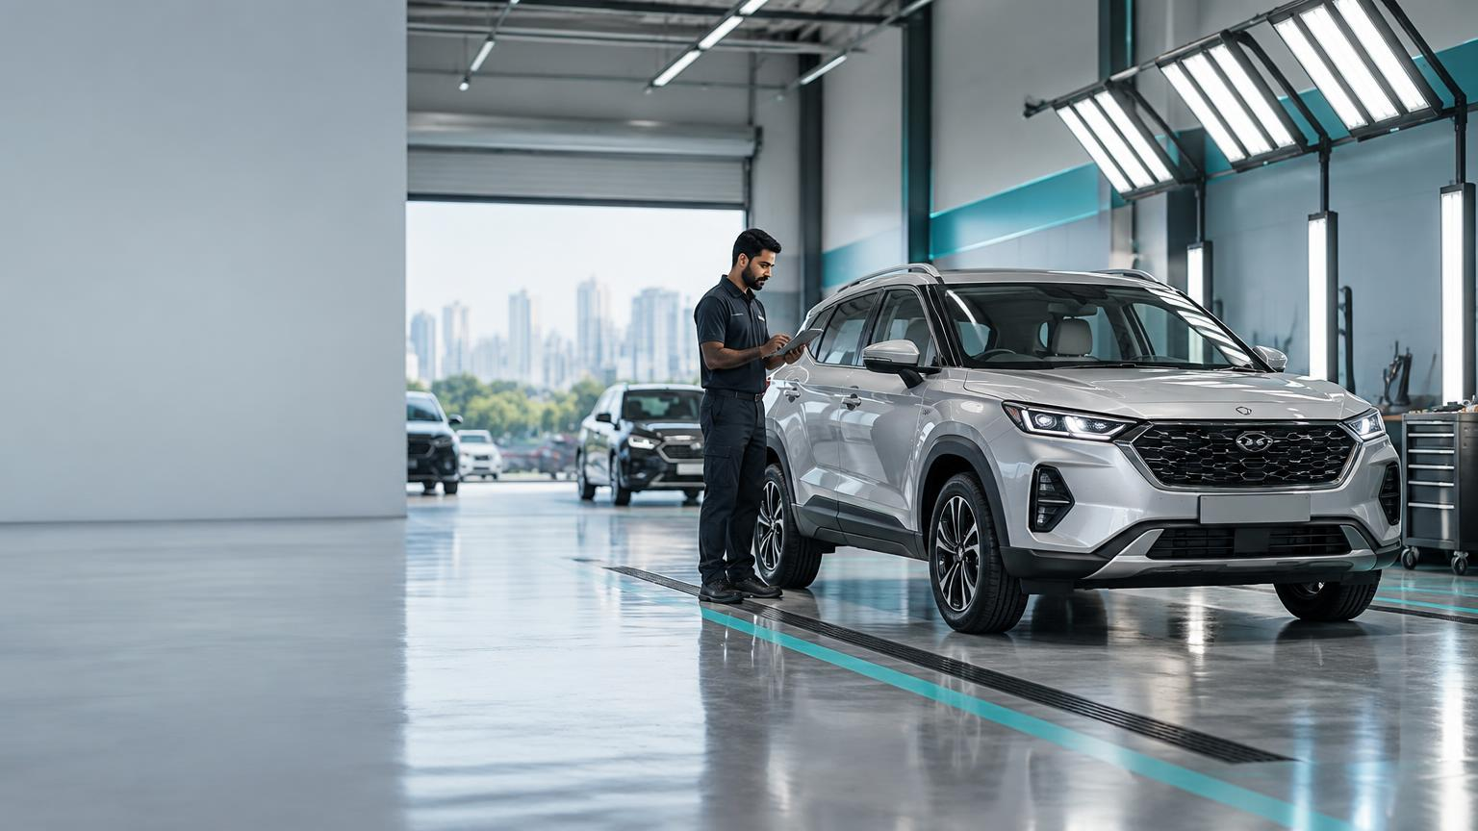
DAY 3 • 27 SEPTEMBER 2026
Pre-Owned
Car Business
Trust, technology and the economics behind every second life on wheels.
SESSION 1 8:45–10:45 • SESSION 2 11:30–1:30
BBA Marketing & Automobile Management • GU Campus

Slide 2
DAY AGENDA
A day built around one question
How does trust become margin in the pre-owned car business?
8:45–10:45
SESSION 1
10:46–11:30
TEA BREAK
Market structure & business models
Conversation with industry experts
11:30–1:30
SESSION 2
1:30 onwards
LUNCH & FELICITATION
Unit economics, regulation & strategy
Close of Day 3

Slide 3
MARKET LENS
SESSION 1 • 8:45–10:45
Market structure &
business models
From sourcing to sale: where value is created, transferred—or lost.
01

Slide 4
SESSION 1
What you should be able to do
1
Map
2
Distinguish
3
Compare
the six-stage used-car value chain
four business-model archetypes
full-stack retail and auction-led models
4
Evaluate
5
Defend
inventory risk, speed, growth and margin
a business-model choice with evidence
120 MINUTES • CONCEPT + ACTIVITY + QUIZ

Slide 5
MARKET PULSE
India’s used-car market: opportunity lives in the gap
7–8 Mn
USD 32–40 Bn
70–80%
vehicles sold annually
estimated market size
transactions unorganised
Volume has roughly doubled over a decade.
A large category still becoming organised.
Trust infrastructure is the addressable opportunity.
THE HEADROOM
India’s used-to-new sales ratio remains below mature markets—meaning trust, financing and certification can still unlock demand.
Figures are directional estimates from the source deck; refresh before external publication.

Slide 6
VALUE CHAIN
Six moments that decide trust—and profit
Ownership choices differ, but no stage disappears.
01
02
03
04
05
06
→
→
→
→
→
SOURCE
INSPECT
REFURBISH
RETAIL
FINANCE
TRANSFER
THE MOAT
Accurate inspection + pricing data reduce the information gap before money changes hands.
WATCH How inspection changes price
CARS24 • practical inspection explainer

Slide 7
BUSINESS MODELS
Four ways to participate in the same transaction
FULL-STACK RETAIL
Buys • refurbishes • retails
AUCTION / WHOLESALE
Buys • routes to dealers
Higher margin potential
Higher inventory risk
Fast turns
Lower refurbishment exposure
CLASSIFIEDS
Connects buyer and seller
OEM CERTIFIED
Trade-in via dealer network
Asset-light
Less control over condition
Protects new-car funnel
Brand-backed trust

Slide 8
CASE COMPARISON
Spinny vs CARS24
Same category. Different operating logic.
FULL-STACK RETAIL
AUCTION-LED → HYBRID
SPINNY
CARS24
Owns inventory longer
Controls refurbishment and retail experience
Earns vehicle margin + ancillary attach
Risk: capital intensity and slow turns
Built around rapid dealer auctions
Growing retail and financing capability
Optimises liquidity and conversion
Risk: thinner control across experience

Slide 9
STRATEGY DEBATE
Growth story or margin story?
SPINNY
CARS24
Scale + vertical integration
Profit discipline + hybridisation
More of the customer journey under one roof
Growth traded for improving margin quality
BOARDROOM QUESTION
Which story would you defend to public-market investors—and what evidence would you demand?

Slide 10
IN-CLASS STUDIO
GROUPS OF 4–5 • 20 MINUTES
Build the business-model map
Own it, outsource it, or skip it—then defend why.
01
02
03
04
Choose: Spinny, CARS24, classifieds, or OEM CPO
Map all six value-chain stages
Find one capability added since founding
Present one strategic trade-off
DELIVERABLE / one-page owned • outsourced • skipped map

Slide 11
SESSION QUIZ
Quick check • Questions 1–3
1
Roughly what share of India’s used-car trade remains unorganised?
A 10–20% B 30–40% C 70–80% D Under 5%
2
Which model buys, refurbishes and retails directly to the consumer?
A Classifieds B Full-stack retail C OEM-only D None
3
CARS24’s original model was primarily…
A OEM CPO B Classifieds C Buy from consumer → auction to dealers D Import

Slide 12
SESSION QUIZ
Quick check • Questions 4–6
4
Which model never takes ownership and earns listing or commission income?
A Full-stack B Auction C Classifieds D OEM CPO
5
What does faster inventory turnover improve most directly?
A Brand awareness B Capital efficiency C Headcount D Footfall
6
What is the central strategic tension in full-stack retail?
A Control vs capital intensity B Import vs export C Petrol vs diesel only D Colour choice

Slide 13
ANSWER KEY
Session 1 • explain the “why,” not only the letter
Q1
C
Most trade remains unorganised.
Q2
B
Full-stack controls buy, refurbish and retail.
Q3
C
The original loop was buy, then dealer auction.
Q4
C
Classifieds connect rather than own.
Q5
B
Faster turns recycle capital more often.
Q6
A
Control improves trust but ties up capital.

Slide 14
PROFIT LENS
SESSION 2 • 11:30–1:30
Unit economics,
regulation & strategy
What makes a used car profitable—and what can derail the model.
02

Slide 15
SESSION 2
Follow the money—and the paperwork
1
P&L
2
Velocity
3
Tax
Build a simplified per-car profit view
Explain inventory turnover
Apply the GST margin logic
4
Trust
5
Strategy
Explain RC transfer and RTO role
Evaluate the next competitive frontier

Slide 16
UNIT ECONOMICS
Illustrative per-car P&L
A ₹6 lakh acquisition leaves little room for error.
LINE ITEM
AMOUNT
SIGNAL
Acquisition
₹6,00,000
100%
Refurbishment
₹15k–30k
2.5–5%
Holding cost
₹500–800/day
Time tax
Documentation
₹3k–5k
0.5–1%
Retail price
₹6.55–6.75L
109–112%
Vehicle margin
₹40k–55k
7–9%
Finance / insurance
₹8k–25k
+1.5–4%
Illustrative classroom assumptions—not investment guidance.

Slide 17
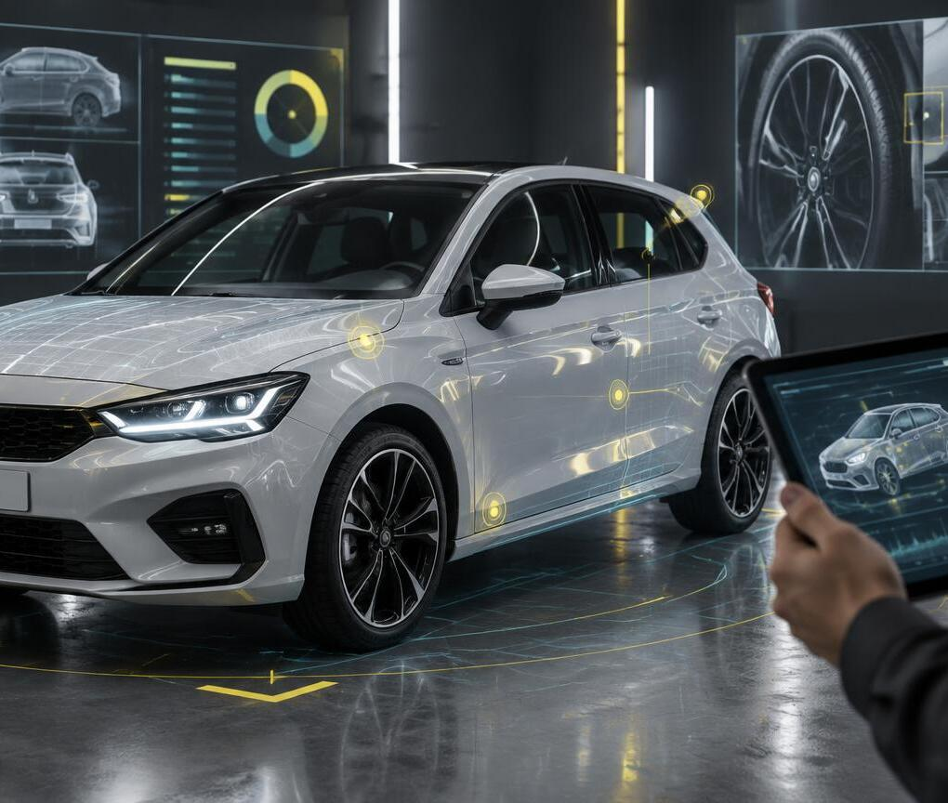
INVENTORY VELOCITY
Every unsold car is a clock running
40 DAYS
→
20 DAYS
Halving holding time can roughly double annual inventory turns for the same deployed capital.
Pricing algorithms and demand forecasting are not back-office tools—they are margin infrastructure.
WATCH Resale value study

Slide 18
REGULATION
Trust has a tax logic—and a paper trail
GST MARGIN SCHEME
RC TRANSFER + RTO
Tax is calculated on the dealer’s margin—not the full sale value—when the prescribed conditions apply.
Why it matters
• Helps organised dealers compete
• Makes acquisition records essential
• No margin means no tax under the scheme
Registration transfer, hypothecation removal and inter-state NOC can be mandatory.
Why it matters
• Delays can leave the seller exposed
• Documentation is a trust service
• Process quality becomes a brand promise
Rule 32(5), CGST Rules • verify current rates and applicability before a transaction.

Slide 19
RISK MAP
Four forces that can erase the margin
!
CASH BURN
!
RESIDUAL VALUE
Growth without unit discipline
The car can depreciate while waiting
!
INFORMATION GAP
!
FINANCE ACCESS
History, odometer and accident uncertainty
Used-car lending still shapes conversion

Slide 20
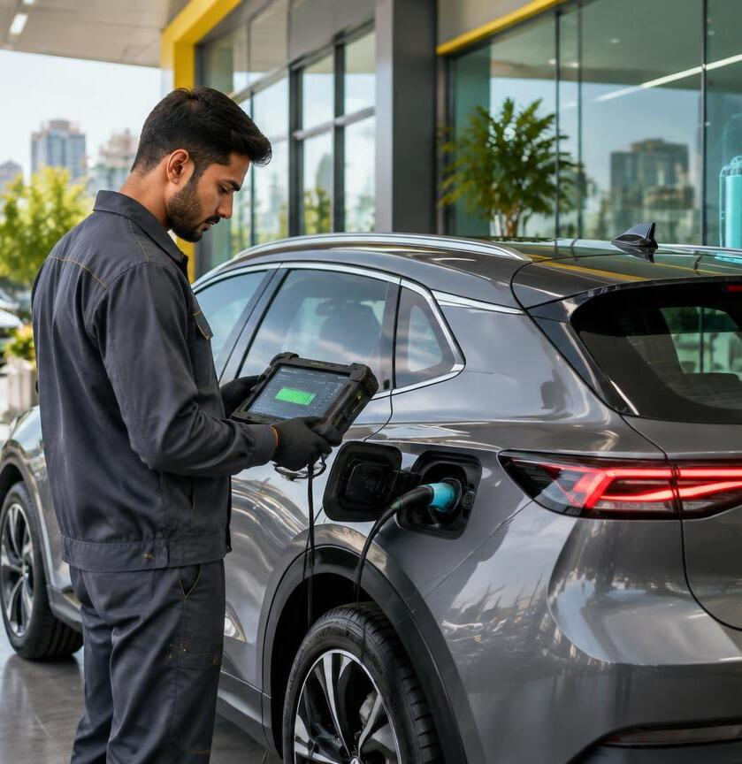
INNOVATION RADAR
The next used-car
moat is data
AI pricing + computer-vision inspection
Verified digital vehicle history
Instant finance + embedded insurance
Used-EV battery state-of-health
Battery identity / lifecycle transparency
WATCH EV battery identity
DISCUSS / What replaces “kilometres driven” as the trust signal for a used EV?

Slide 21
FINANCE LAB
PAIRS • 20 MINUTES
Find the lever that moves profit
Build a P&L for a five-year-old hatchback acquired at ₹3,50,000.
HOLDING DAYS
REFURBISHMENT
FINANCE ATTACH
20 / 30 / 45
₹10k / ₹20k / ₹35k
0% / 30% / 60%
DELIVERABLE / one completed P&L + one sentence naming the highest-impact lever

Slide 22
SESSION QUIZ
Quick check • Questions 1–3
1
Under the GST margin scheme, tax is charged on…
A Full sale price B Margin C Purchase price D No GST ever
2
Which process fully releases the seller from vehicle liability?
A Insurance card B RC transfer + hypothecation removal C Warranty D Loyalty card
3
Reducing holding period primarily improves…
A Awareness B Capital efficiency C Headcount D Footfall

Slide 23
SESSION QUIZ
Quick check • Questions 4–6
4
The “lemons market” problem describes…
A Colour preference B Information asymmetry C Fruit transport D Software bug
5
Which is NOT a normal industry challenge?
A Cash burn B Residual-value risk C Zero informal competition D Finance penetration
6
Which trend changes EV resale valuation most directly?
A Subscriptions B Battery state-of-health C Classified listings D Paint colour

Slide 24
ANSWER KEY
Session 2 • connect each answer to the business consequence
Q1
B
Tax applies to the qualifying margin.
Q2
B
Transfer closes seller liability.
Q3
B
Faster turns improve capital efficiency.
Q4
B
Condition knowledge is uneven.
Q5
C
Informal competition is very real.
Q6
B
Battery health drives range and value.

Slide 25
STUDENT HANDOUT
Day 3 • follow-along key points
Use this page for notes during discussion and activities.
MARKET
7–8 million annual transactions; 70–80% remains unorganised.
MODELS
Full-stack, auction/wholesale, classifieds and OEM-certified pre-owned.
VALUE CHAIN
Source → inspect → refurbish → retail → finance → transfer.
ECONOMICS
Margin is thin; holding days, refurbishment and finance attach matter.
TRUST
Inspection, pricing evidence, warranty and RC transfer reduce uncertainty.
NEXT FRONTIER
AI valuation, digital history and EV battery health will reshape resale.
MY TAKEAWAY / ____________________________________________
QUESTION / __________________________

Slide 26
DAY 3 / CLOSE
Trust is the product.
The car is the inventory.
01
MARKET
Organisation grows when trust becomes visible.
02
MODEL
Ownership choice determines margin and risk.
03
MONEY
Turnover and ancillary attach drive economics.
04
NEXT
Vehicle data and battery health reshape resale.
LUNCH & FELICITATION • 1:30 ONWARDS
Tomorrow / Vehicle Transport Management

