Slide 1
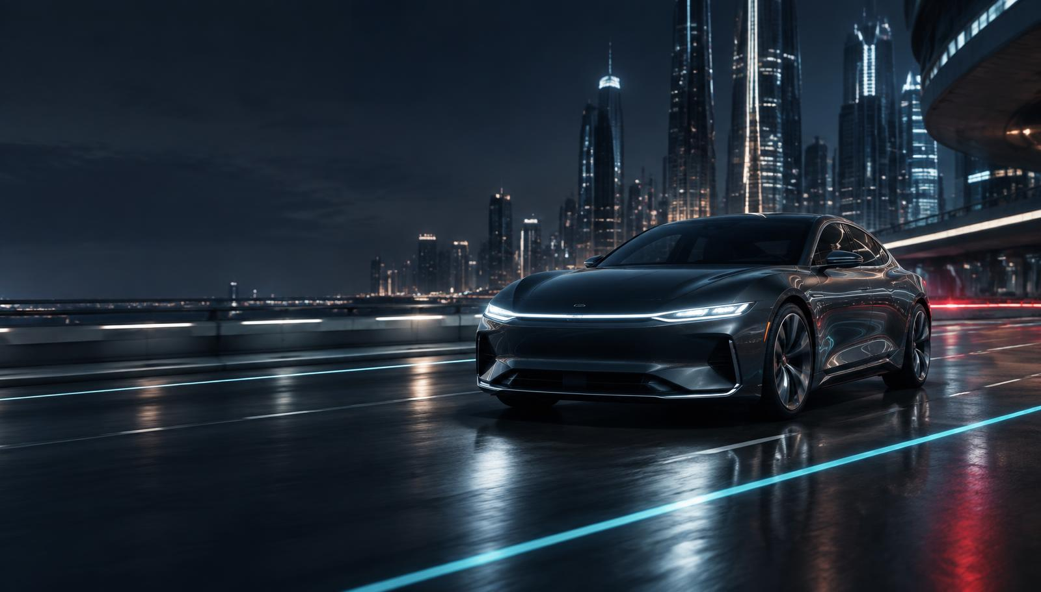
INDUSTRIAL WORKSHOP · 26 SEPTEMBER 2026
Automotive
Futuristic Technology
Electrification, connectivity and autonomy reshaping the vehicle
DAY 2
Session 1 8:45–10:45 • Session 2 11:30–1:30

Slide 2
DAY 2
Schedule at a Glance
8:45
10:45
10:46
11:30
11:30
1:30
1:30
onwards
01
—
02
—
Electrification
Tea Break
Connected & Autonomous
Lunch & Felicitation
Powertrains, batteries & charging
Networking with industry experts
Sensors, V2X, software and safety
Close of Day 2
DAY 2 / AUTOMOTIVE FUTURISTIC TECHNOLOGY
02

Slide 3
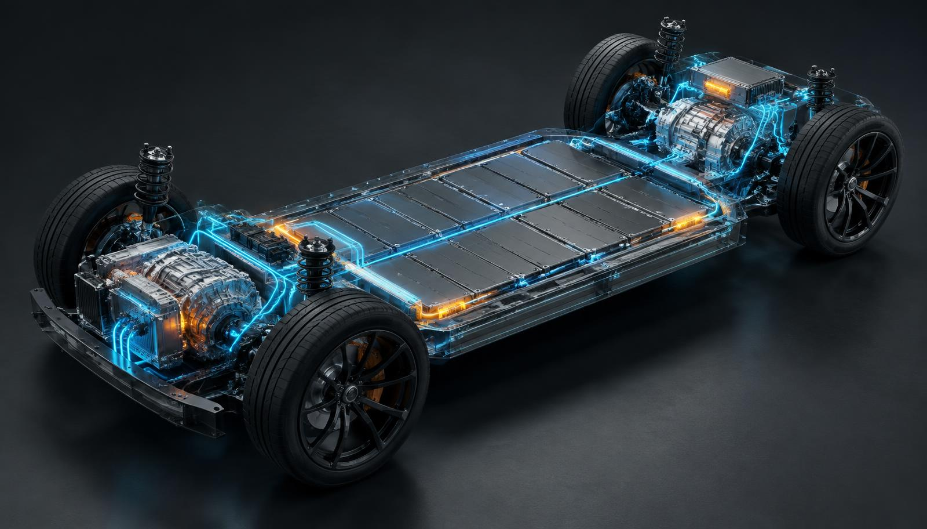
01
SESSION 1 • 8:45–10:45
Electrification
Powertrains, Batteries & Charging
Why powertrain choice is now a business decision — not only an engineering one.
DAY 2 / AUTOMOTIVE FUTURISTIC TECHNOLOGY
03

Slide 4
SESSION 1 · ELECTRIFICATION
Learning Objectives
1
Differentiate ICE, hybrid, BEV and FCEV powertrains
2
Identify the core EV powertrain components
3
Compare AC, DC, swapping and bidirectional charging
4
Explain regenerative braking and range impact
5
Outline India’s key EV policy instruments
120 MIN · INCLUDES TUTORIAL + QUIZ
DAY 2 / AUTOMOTIVE FUTURISTIC TECHNOLOGY
04

Slide 5
SESSION 1 · FOUNDATION
Powertrain Options Compared
ICE
HEV
PHEV
BEV
FCEV
Mature infrastructure
Fast refuelling · tailpipe emissions
Engine + small battery
Regeneration · no plug required
Engine + larger battery
Plug-in electric range + fuel backup
Battery + motor
Zero tailpipe emissions · low running cost
Hydrogen fuel cell
Fast refuelling · nascent infrastructure
01
02
03
04
05
DAY 2 / AUTOMOTIVE FUTURISTIC TECHNOLOGY
05

Slide 6
SESSION 1 · ARCHITECTURE
Core EV Powertrain Components
1
BATTERY PACK
Stores propulsion energy; common chemistries include LFP and NMC
2
ELECTRIC MOTOR
Converts electrical energy into wheel torque
3
INVERTER
Converts DC to AC and controls torque delivery
4
BMS
Monitors cells, temperature, safety and balancing
5
ON-BOARD CHARGER
Converts grid AC into DC for the battery
06
DAY 2 / AUTOMOTIVE FUTURISTIC TECHNOLOGY
06
DAY 2 / AUTOMOTIVE FUTURISTIC TECHNOLOGY

Slide 7
SESSION 1 · ENERGY INTERFACE
The Charging Ecosystem
AC / HOME
DC FAST
BATTERY SWAP
V2G / SMART
3–22 kW
Type 2 · typically overnight
50–350 kW
CCS2 / GB-T · highway corridors
Minutes
2W / 3W fleet operations
Bidirectional
Vehicle supports home or grid
DAY 2 / AUTOMOTIVE FUTURISTIC TECHNOLOGY
07

Slide 8
SESSION 1 · ENERGY RECOVERY
Regenerative Braking
DECELERATE
MOTOR → GENERATOR
ELECTRICITY
RECHARGE
Vehicle kinetic energy
Torque reverses
Energy flows to battery
Useful range recovered
UP TO 20%
1-PEDAL
LOWER WEAR
Approximate city-driving range recovered through regeneration
Strong regeneration can enable one-pedal driving
Reduced friction-brake use can lower service demand
08
DAY 2 / AUTOMOTIVE FUTURISTIC TECHNOLOGY
08
DAY 2 / AUTOMOTIVE FUTURISTIC TECHNOLOGY

Slide 9
SESSION 1 · POLICY LANDSCAPE
India’s EV Policy Push
FAME-II
PLI-AUTO
PM E-DRIVE
2019–2024 · concluded
2021–2028
2024–2026
₹11,500 Cr
₹25,938 Cr
₹10,900 Cr
Demand incentives
Advanced manufacturing
Successor support scheme
Schemes, outlays and timelines change. Verify current status before each teaching cycle.
DAY 2 / AUTOMOTIVE FUTURISTIC TECHNOLOGY
09

Slide 10
TUTORIAL · 20 MINUTES
EV vs ICE — Total Cost of Ownership
SMALL GROUPS
1
Compare a petrol hatchback and a similar BEV
DELIVERABLE
A one-page TCO comparison table with the calculated breakeven point — ready to present.
2
Calculate 5-year energy + maintenance cost
3
Add the purchase-price difference
4
Find the BEV breakeven annual distance
10
DAY 2 / AUTOMOTIVE FUTURISTIC TECHNOLOGY
10
DAY 2 / AUTOMOTIVE FUTURISTIC TECHNOLOGY

Slide 11
SESSION 1 · QUICK CHECK
Questions 1–3
1
Which powertrain produces zero tailpipe emissions?
A ICE B Hybrid (HEV) C Battery-electric (BEV) D None
2
Which component converts DC battery power to AC for the motor?
A BMS B Inverter / power electronics C On-board charger D Battery pack
3
DC fast charging typically operates in which power range?
A 3–7 kW B 11–22 kW C 50–350 kW D 1–2 kW
DAY 2 / AUTOMOTIVE FUTURISTIC TECHNOLOGY
11

Slide 12
SESSION 1 · QUICK CHECK
Questions 4–6
4
Regenerative braking primarily helps by:
A Increasing top speed B Recovering energy during deceleration C Reducing weight D Increasing tyre life only
5
FAME-II was primarily a:
A Manufacturing scheme B Demand-side incentive C Charging regulation only D Import tariff policy
6
PLI-Auto is designed to incentivise:
A EV buyers directly B Domestic advanced automotive manufacturing C Fuel retailers D State transport corporations only
DAY 2 / AUTOMOTIVE FUTURISTIC TECHNOLOGY
12

Slide 13
SESSION 1 · REVIEW
Answer Key
1
C
BEVs have no tailpipe
4
B
Regeneration recovers braking energy
2
B
Inverter converts DC to AC
5
B
FAME-II targeted buyer-side demand
3
C
DC fast charging is high-power
6
B
PLI-Auto rewards domestic manufacturing
13
DAY 2 / AUTOMOTIVE FUTURISTIC TECHNOLOGY
13
DAY 2 / AUTOMOTIVE FUTURISTIC TECHNOLOGY

Slide 14
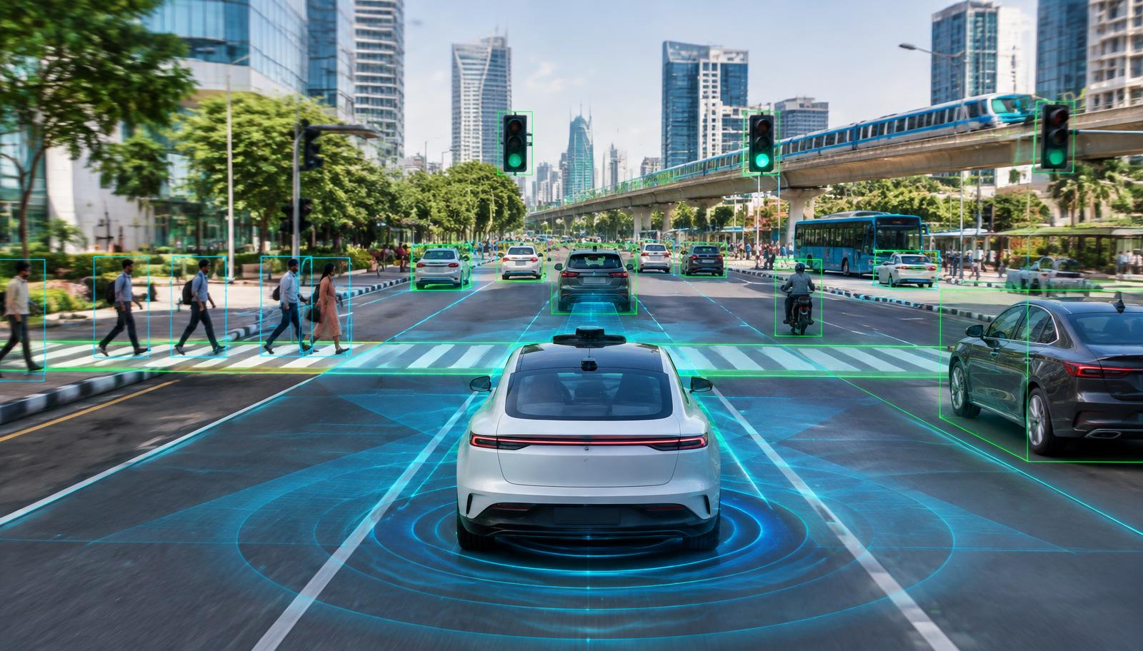
02
SESSION 2 • 11:30–1:30
Connected &
Autonomous Vehicles
From driver assistance to a connected, software-defined fleet.
DAY 2 / AUTOMOTIVE FUTURISTIC TECHNOLOGY
14

Slide 15
SESSION 2 · CONNECTED & AUTONOMOUS
Learning Objectives
1
Explain SAE automation levels 0–5
2
Describe camera, radar, LiDAR and ultrasonic sensing
3
Explain V2X communication and ecosystem roles
4
Describe telematics, OTA and business implications
5
Identify cyber risks and mitigation approaches
120 MIN · INCLUDES TUTORIAL + QUIZ
DAY 2 / AUTOMOTIVE FUTURISTIC TECHNOLOGY
15

Slide 16
SESSION 2 · AUTOMATION SCALE
SAE Levels of Driving Automation
0
1
2
3
4
5
NO AUTOMATION
ASSISTANCE
PARTIAL
CONDITIONAL
HIGH
FULL
Driver performs all tasks
One function automated
Steering + acceleration; driver monitors
System drives; takeover expected
No driver in defined domain
No human driver under any condition
MOST CURRENT INDIAN ROAD ADAS
16
DAY 2 / AUTOMOTIVE FUTURISTIC TECHNOLOGY
16
DAY 2 / AUTOMOTIVE FUTURISTIC TECHNOLOGY

Slide 17
SESSION 2 · PERCEPTION
The ADAS Sensor Suite
CAMERA
RADAR
LiDAR
ULTRASONIC
Semantic detail
Lanes · signs · objects
Weather sensitive
Range + velocity
Works in poor visibility
Lower visual detail
Precise 3D geometry
High-resolution mapping
Higher cost
Short range
Parking · low-speed manoeuvres
Limited distance
SENSOR FUSION / COMBINE MODALITIES FOR REDUNDANCY + ACCURACY
DAY 2 / AUTOMOTIVE FUTURISTIC TECHNOLOGY
17

Slide 18
SESSION 2 · V2X + SOFTWARE
Connectivity Building Blocks
V2V Vehicles
V2I Infrastructure
Hazard + collision warnings
Signals + road conditions
CONNECTED
VEHICLE
V2P Pedestrians
V2N Network
Crossing safety alerts
Cloud + cellular services
Telematics turns vehicle data into fleet visibility, diagnostics and driver insights. OTA delivers software features and fixes without a service visit.
DAY 2 / AUTOMOTIVE FUTURISTIC TECHNOLOGY
18

Slide 19
SESSION 2 · TRUST ARCHITECTURE
Cybersecurity in Connected Vehicles
ATTACK SURFACE
Infotainment · telematics · OTA · V2X
UN
R155 / R156
KEY RISKS
Remote access · privacy breach · GPS spoofing
DEFENCE
Global automotive cybersecurity and software-update management regulations
Secure boot · encryption · detection · OTA patching
19
DAY 2 / AUTOMOTIVE FUTURISTIC TECHNOLOGY
19
DAY 2 / AUTOMOTIVE FUTURISTIC TECHNOLOGY

Slide 20
TUTORIAL · 20 MINUTES
Feature-to-Level Mapping + Connected-Car Pitch
GROUPS OF 4
1
Map six driver-assistance features to SAE 0–5
DELIVERABLE
A completed feature-to-SAE-level map plus a one-paragraph pitch for the new connected feature.
2
Design one connected feature for an Indian urban commuter
3
Name the required sensor, V2X, telematics or OTA capability
4
Prepare a 90-second pitch
20
DAY 2 / AUTOMOTIVE FUTURISTIC TECHNOLOGY
20
DAY 2 / AUTOMOTIVE FUTURISTIC TECHNOLOGY

Slide 21
SESSION 2 · QUICK CHECK
Questions 1–3
1
At which SAE level can the vehicle handle all driving within a defined domain?
A Level 2 B Level 3 C Level 4 D Level 1
2
Which sensor produces precise 3D mapping using laser pulses?
A Camera B Radar C LiDAR D Ultrasonic
3
V2I communication refers to:
A Vehicle-to-vehicle B Vehicle-to-infrastructure C Vehicle-to-pedestrian D Vehicle-to-network
DAY 2 / AUTOMOTIVE FUTURISTIC TECHNOLOGY
21

Slide 22
SESSION 2 · QUICK CHECK
Questions 4–6
4
OTA updates allow manufacturers to:
A Replace hardware remotely B Push software without a service visit C Change registration D Eliminate all recalls
5
Combining camera, radar and LiDAR data is called:
A Sensor fusion B Sensor swapping C Data hybridisation D Signal cloning
6
UN R155 / R156 primarily govern:
A Emissions B Cybersecurity + software updates C Crash ratings D Fuel labels
DAY 2 / AUTOMOTIVE FUTURISTIC TECHNOLOGY
22

Slide 23
SESSION 2 · REVIEW
Answer Key
1
C
Level 4 handles a defined domain fully
4
B
OTA delivers software remotely
2
C
LiDAR produces precise 3D maps
5
A
Sensor fusion combines modalities
3
B
V2I is vehicle-to-infrastructure
6
B
R155 / R156 cover cyber + OTA
23
DAY 2 / AUTOMOTIVE FUTURISTIC TECHNOLOGY
23
DAY 2 / AUTOMOTIVE FUTURISTIC TECHNOLOGY

Slide 24
FUTURE WATCH · EVIDENCE-LED SIGNALS
Innovation Radar — What Is Coming Next
SOLID-STATE CELLS
MEGAWATT CHARGING
ZONAL COMPUTE
Public-road prototypes are moving battery research into vehicle validation.
MCS standardization targets heavy-duty charging with much shorter depot stops.
Central compute + zonal electronics can simplify wiring and accelerate OTA delivery.
Mercedes-Benz + BMW road trials
CharIN · IEC TS 63379
Software-defined vehicle architecture
BIDIRECTIONAL ENERGY
END-TO-END DRIVING AI
HYDROGEN PATHWAYS
ISO 15118-20 and related standards support vehicle-to-home and vehicle-to-grid pathways.
Integrated neural driving stacks are being demonstrated for complex urban navigation.
Fuel cells remain under development for selected commercial and long-range use cases.
V2H · V2G
Research + production pilots
Heavy-duty + infrastructure-dependent
24
DAY 2 / AUTOMOTIVE FUTURISTIC TECHNOLOGY
24
DAY 2 / AUTOMOTIVE FUTURISTIC TECHNOLOGY

Slide 25
CURATED VIDEO LINKS · OFFICIAL SOURCES
Watch & Discuss
HYDROGEN CONCEPT
AI-POWERED VEHICLES
URBAN AUTONOMY
Hyundai Motor Group
INITIUM fuel-cell concept film
SAE International
Digital chassis and software-defined experiences
NVIDIA
L2++ driving stack navigating San Francisco
PLAY VIDEO ↗
PLAY VIDEO ↗
PLAY VIDEO ↗
Discussion prompt: Which technology solves a real customer or infrastructure problem — and what must mature before scale?
DAY 2 / AUTOMOTIVE FUTURISTIC TECHNOLOGY
25

Slide 26
DAY 2 SUMMARY
Four ideas to carry forward
1
Electrification is a spectrum — choose by use case and infrastructure.
2
EV economics depend on battery cost, charging access and total ownership cost.
3
Automation is graduated; most current Indian-road ADAS remains Level 2.
4
Connectivity creates recurring value — and new cybersecurity obligations.
Tomorrow’s vehicle is electric, connected, updateable — and accountable.

