Slide 1
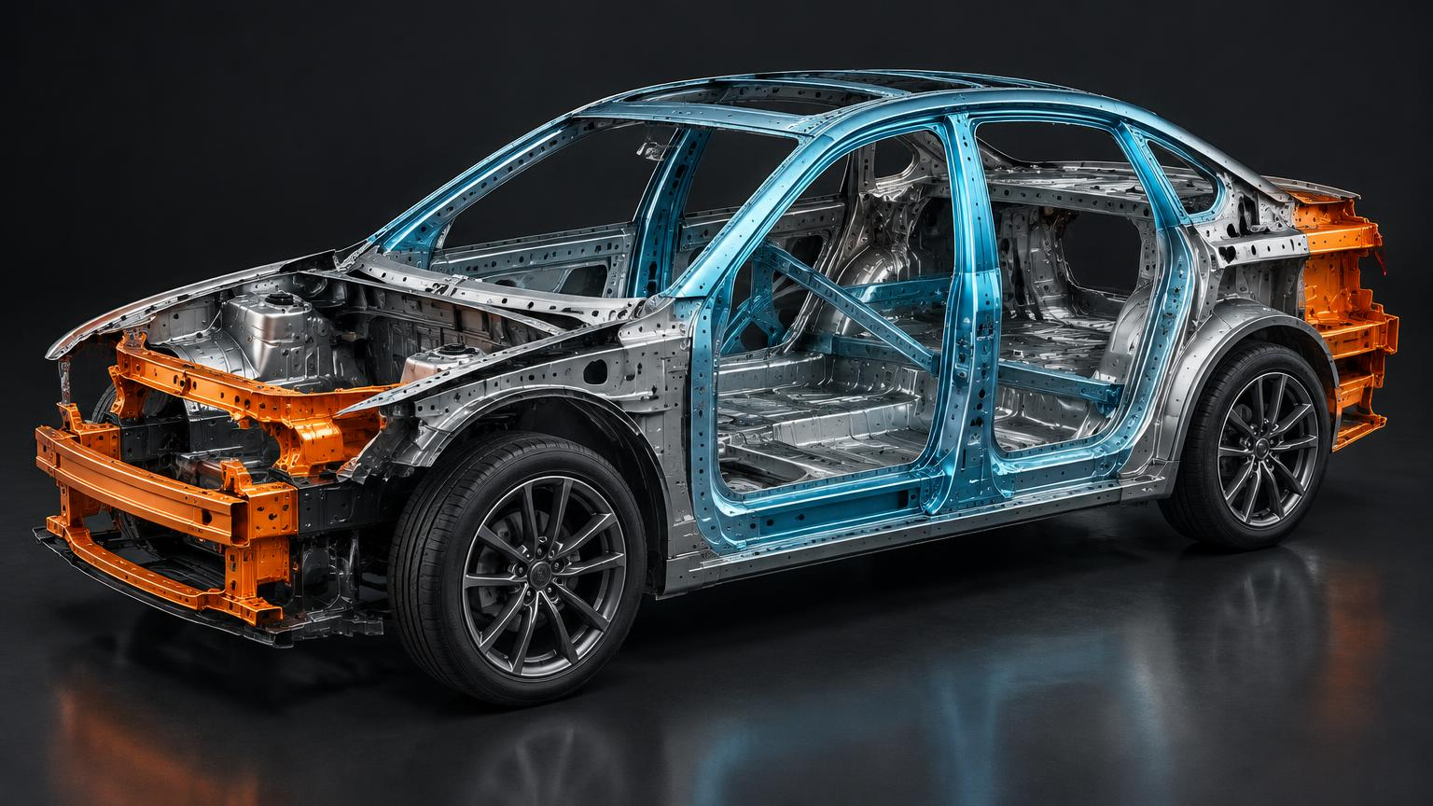
DAY 1
Vehicle Body Engineering
& Fundamental Maintenance
From structural design and crash safety to preventive care and diagnostics
25 SEPTEMBER 2026 • GU CAMPUS, GREATER NOIDA
8:45–10:45 Session 1 | 11:30–1:30 Session 2

Slide 2
DAY AGENDA
One day. Two engineering lenses.
The revised workshop progression from structure to service.
8:45–10:45 / SESSION 1
10:46–11:30 / TEA BREAK
Vehicle Body — Construction, Materials & Safety
Networking with industry experts
11:30–1:30 / SESSION 2
1:30 onward / LUNCH + FELICITATION
Fundamental Maintenance — Preventive Care & Diagnostics
Close of Day 1

Slide 3
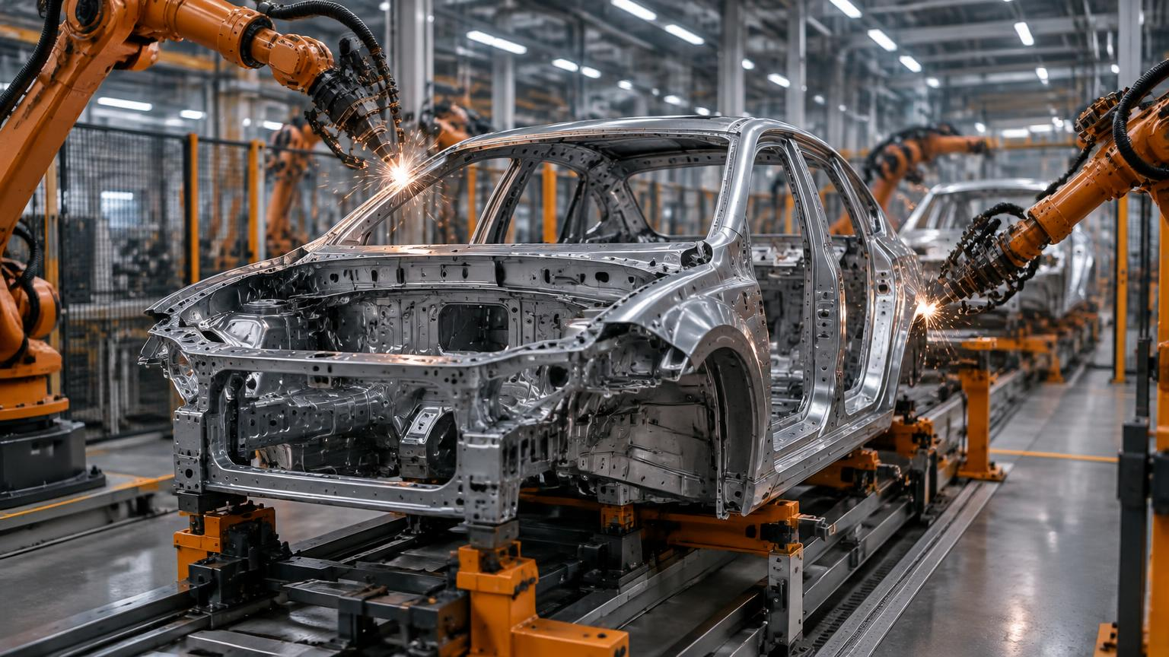
01
Vehicle Body — Construction, Materials & Safety
How a body is designed, built and protected — and why those choices shape cost, weight, repairability and safety.

Slide 4
SESSION 1
What you should be able to explain
Five outcomes connect engineering choices to customer and business value.
01
02
Classify body styles and explain the body’s system role
Compare body-on-frame, unibody and space-frame construction
03
04
Evaluate materials on weight, cost, crash performance and repairability
Explain crumple zones, safety cages and pillar structures
05
Trace the Body-in-White manufacturing and corrosion-protection sequence

Slide 5
SESSION 1 / CONCEPT
The body is more than an outer shell
It integrates safety, structure, efficiency, comfort and brand expression.
PROTECT
CARRY
SHAPE
REFINE
SIGNAL
Occupant safety cage
Powertrain + suspension
Aerodynamics + energy use
Noise, vibration + harshness
Brand identity + segment
BODY STYLES / Sedan • Hatchback • SUV/Crossover • MPV • Coupe • Pick-up

Slide 6
SESSION 1 / CONCEPT
Three construction architectures
Every architecture is a compromise between ruggedness, mass, volume and tooling cost.
BODY-ON-FRAME
UNIBODY
SPACE FRAME
Separate ladder chassis + bolted body
Best fit: Pick-ups, rugged SUVs, commercial vehicles
Durable / repairable / heavy
Body and chassis form one welded shell
Best fit: Most passenger cars and crossovers
Light / refined / predictable crash path
Load-bearing skeleton + non-structural skins
Best fit: Low-volume performance and select EVs
Very light / flexible skins / costly
CLASS PROMPT Which architecture is beneath the vehicle you arrived in today — and what evidence supports your answer?

Slide 7
SESSION 1 / DECISION MATRIX
Body material trade-offs
No material wins every dimension; programme priorities determine the mix.
MATERIAL | WEIGHT | COST | REPAIRABILITY | TYPICAL USE
Mild / HSS steel | Baseline | Low | Easy | Mass-market panels + structure
AHSS / UHSS | 10–15% lighter | Moderate | Specialist welding | Pillars + sills
Aluminium | 30–40% lighter | High | Specialist repair | Bonnets, doors, premium/EV
Composites / CFRP | Lightest | Very high | Difficult | Low-volume performance
Engineering plastics | Light | Low–moderate | Replaceable | Bumpers, fenders, trim
Management lens / Lightweighting can lower energy use — but specialist repairs may raise ownership and insurance cost.

Slide 8
SESSION 1 / SAFETY
Design deformation. Preserve survival space.
CRUMPLE ZONES
Progressively absorb kinetic energy
SAFETY CAGE
UHSS resists cabin deformation
A / B / C PILLARS
Manage roof-crush and side-impact loads
CRASH BOXES
Contain low-speed repair cost
PLAY IIHS: Understanding Car Crashes

Slide 9
SESSION 1 / MANUFACTURING
From coil to complete vehicle
Body-in-White is the structural shell before paint, trim and powertrain installation.
01 STAMPING
02 BIW + WELDING
03 E-COAT + PAINT
04 FINAL ASSEMBLY
Coils pressed into panels
Panels joined into a shell
Corrosion barrier + finish
Glass, trim, closures + powertrain
PLAY Toyota Virtual Plant Tour

Slide 10
TUTORIAL / 20 MINUTES
Body architecture + material decision
Work in groups of 4–5. Build a decision, not just an engineering description.
Urban hatchback
Premium mid-size SUV
Battery-electric crossover
Light commercial pick-up
YOUR TASK
DELIVERABLE
Choose the architecture and primary material mix. Justify against target price, weight/efficiency, crash safety and repair cost.
One-page decision matrix plus a two-minute pitch. Nominate one spokesperson; expect one challenge question from the class.
DECISION TEST / Would the customer understand why your choice is worth paying for?

Slide 11
SESSION 1 / QUICK CHECK
Questions 1–3
Choose one answer. Be ready to explain the engineering reason.
1. Which construction integrates body and chassis into one shell?
A. Body-on-frame B. Unibody / monocoque C. Space frame D. Ladder frame
2. Which material cuts panel weight roughly 30–40% versus steel?
A. Mild steel B. AHSS C. Aluminium D. UHSS
3. What is the primary purpose of a crumple zone?
A. Increase top speed B. Absorb crash energy progressively C. Reduce vehicle weight D. Improve economy

Slide 12
SESSION 1 / QUICK CHECK
Questions 4–6
Choose one answer. Be ready to explain the engineering reason.
4. Body-on-frame is most commonly retained in:
A. Compact hatchbacks B. Sports cars C. SUVs and pick-ups D. City EVs
5. UHSS is primarily used in:
A. Bumpers B. A/B-pillars and safety cage C. Bonnet skin D. Interior trim
6. E-coating in BIW primarily provides:
A. Paint gloss B. Corrosion protection C. Lower cabin noise D. Lower vehicle mass

Slide 13
SESSION 1
Answer key
Check both the answer and the reason.
Q1 / B
Q2 / C
Unibody integrates body + chassis
Aluminium cuts panel weight
Q3 / B
Q4 / C
Progressive energy absorption
Ruggedness + payload
Q5 / B
Q6 / B
Protects passenger cell
E-coat is a corrosion barrier

Slide 14
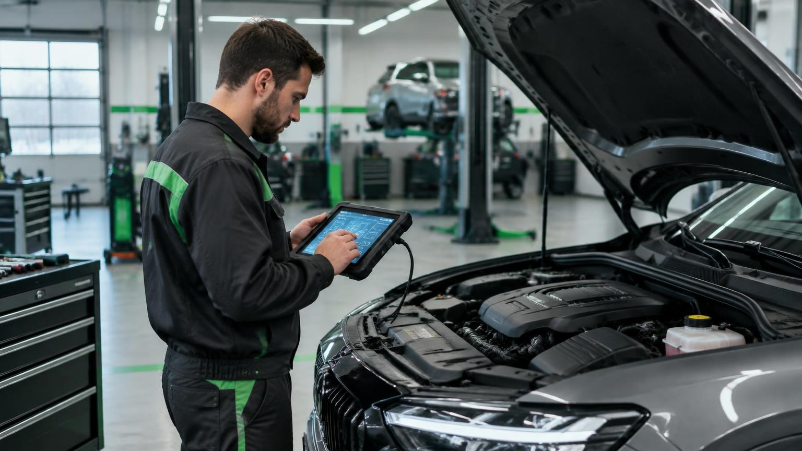
02
Fundamental Maintenance — Preventive Care & Diagnostics
Read a service schedule, a warning light and an OBD-II code as fluently as a product specification.

Slide 15
SESSION 2
What you should be able to apply
Five outcomes move from strategy to customer communication.
01
02
Distinguish preventive, predictive and corrective maintenance
Apply a manufacturer’s periodic maintenance schedule
03
04
Prioritise core service items and typical intervals
Interpret dashboard warnings and basic OBD-II codes
05
Connect maintenance quality to total cost and resale value

Slide 16
SESSION 2 / STRATEGY
When should the vehicle be serviced?
The answer shifts as connected data improves visibility into actual component condition.
PREVENTIVE
CORRECTIVE
PREDICTIVE
Scheduled by time or mileage.
Predictable and safe; may replace parts before necessary.
Repair after failure.
Low short-term spend; high downtime, damage and safety risk.
Triggered by sensor, OBD or telematics data.
Better timing; depends on reliable data and diagnosis.
CONNECTED SHIFT / Continuous inspection creates the health record that supports all three strategies.

Slide 17
SESSION 2 / SERVICE PLANNER
Core periodic service items
Intervals are typical teaching references; always check the manufacturer schedule.
ITEM | TYPICAL INTERVAL | RISK IF SKIPPED
Engine oil + filter | 5,000–10,000 km / 6 months | Accelerated engine wear
Air filter | 10,000–15,000 km | Lower power, higher consumption
Brake pads / discs | 20,000–40,000 km | Reduced stopping power
Coolant | ~40,000 km / 2 years | Overheating and engine damage
Battery + terminals | Check every visit / 3–5 years | Starting and electrical failure
Tyres | Rotate 8,000–10,000 km | Uneven wear, poor handling

Slide 18
SESSION 2 / PROCESS
Anatomy of a service visit
A good customer experience is a controlled flow of evidence, work and communication.
01 INTAKE
02 SCAN
03 EXECUTE
04 VERIFY
05 HANDOVER
Concern, mileage, history
OBD + visual inspection
Fluids, filters, wear parts
Quality check + road test
Invoice, warranty, next date
→
→
→
→
SERVICE MANAGEMENT PRINCIPLE / Every recommendation should be traceable to inspection evidence.

Slide 19
SESSION 2 / DIAGNOSTICS
Read the warning. Judge the urgency.
CHECK ENGINE
Retrieve DTC; diagnose engine/emissions fault
OIL PRESSURE
Stop safely — engine seizure risk
BATTERY / CHARGING
Check alternator and battery
BRAKE SYSTEM
Check fluid, pads and safe operation
OBD-II / Standard diagnostic interface • P0XXX / Standard powertrain code family
PLAY OBD2 explained

Slide 20
TUTORIAL / 20 MINUTES
Maintenance planner + service-advisor role-play
Work in pairs. Convert technical need into customer confidence.
PROFILE A
PROFILE B
4-year-old petrol hatchback
52,000 km
Last service: 8 months ago
Mark each item: OVERDUE / DUE SOON / MONITOR
2-year-old diesel SUV
60% highway use
Swap advisor/customer roles and repeat the explanation in plain language.
DELIVERABLE / Two prioritised maintenance checklists ready to hand to a customer.

Slide 21
SESSION 2 / QUICK CHECK
Questions 1–3
Choose the safest and most operationally sound answer.
1. Which strategy relies on real-time condition data?
A. Preventive B. Corrective C. Predictive D. Statutory
2. An oil-pressure warning while driving means:
A. Continue B. Stop safely and switch off C. Check next service D. Ignore if quiet
3. OBD stands for:
A. On-Board Diagnostics B. Overall Body Design C. Operational Brake Device D. On-Board Drivetrain

Slide 22
SESSION 2 / QUICK CHECK
Questions 4–6
Choose the safest and most operationally sound answer.
4. Skipping coolant replacement primarily risks:
A. Tyre wear B. Engine overheating C. Battery drain D. Brake fade
5. Tyre rotation is primarily done to:
A. Increase speed B. Promote even wear C. Reduce engine load D. Improve paint
6. A code such as P0301 is generated by:
A. Infotainment B. ECU via OBD-II C. Tyre sensor only D. Insurance company

Slide 23
SESSION 2
Answer key
The best answer protects safety, uptime and customer trust.
Q1 / C
Q2 / B
Predictive uses live condition data
Stop: engine seizure risk
Q3 / A
Q4 / B
On-Board Diagnostics
Coolant protects against overheating
Q5 / B
Q6 / B
Rotation promotes even tread wear
ECU generates DTCs through OBD-II

Slide 24
DAY SUMMARY
Four ideas to carry into the industry
Engineering literacy strengthens marketing, service and ownership decisions.
BODY = SYSTEM
ARCHITECTURE = TRADE-OFF
Structure, safety, aerodynamics, NVH and brand
Weight, cost, use case and repairability
MAINTENANCE = VALUE
DATA = NEXT ADVANTAGE
Safety, uptime, total cost and resale
OBD + telematics enable predictive care
NEXT / DAY 2 — AUTOMOTIVE FUTURISTIC TECHNOLOGIES

Slide 25
STUDENT HANDOUT
Day 1 — follow-along page
Capture the decisions and language you can reuse in class discussion.
01
The vehicle body combines structural, safety and brand roles.
02
Unibody dominates passenger cars; body-on-frame serves rugged use cases.
03
Material choice balances mass, cost, crash performance and repairability.
04
Crumple zones deform; the safety cage preserves survival space.
05
Preventive and predictive maintenance protect safety and resale value.
06
OBD-II converts vehicle faults into structured diagnostic evidence.
MY TAKEAWAY
MY QUESTION
CLASSROOM CHALLENGE / Explain one maintenance recommendation without using technical jargon.

